Slide 1
EMPLOYING SMART UNITS AND SERVITIZATION TOWARDS RECONFIGURABLE MANUFACTURING PROCESSES
by
Stelian BRAD and Mircea MURAR
Presenting author: Stelian BRAD
Technical University of Cluj-Napoca
Cluj-Napoca, ROMANIA
stelian.brad@staff.utcluj.ro
mircea.murar@muri.utcluj.ro

Slide 2
Agenda
Problem statement
Challenge
Putting the concept into practice
Experimental application
Results and further research directions

Slide 3
Problem statement

Slide 4
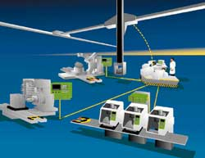
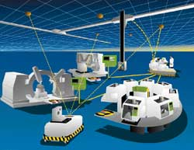
Reconfigurable manufacturing systems
Producer of ****
Producer of grippers
Producer of robots
Producer of machine tools
Design for LC
(excellence)
User needs the optimal solution
IPSS
Who?
How?
Business model
"exactly the functionality and capacity needed, exactly when needed“
Clustering
Niche
Strategic alignment
Co-opetition
Open innovation
From micro to mezzo economy
Polycentric innovation
Y. Korem, 2013

Slide 5
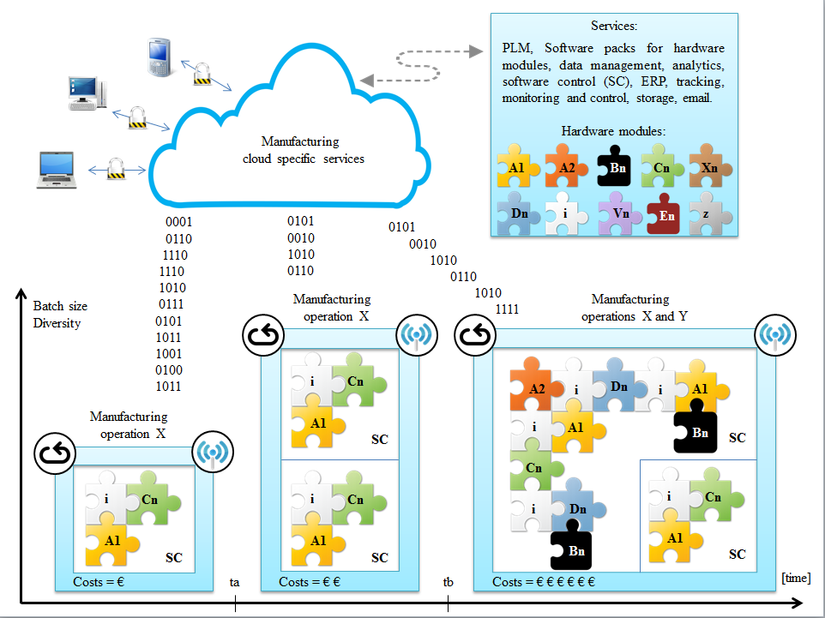
RMS – IPSS
CLUSTER-BASED LOGISTIC AND COMPETENCE CENTRES

Slide 6
Challenge

Slide 7
Reconfigurability characteristics
Reconfigurability
Modularity
Convertibility
Scalability
Diagnosability
Flexible customization
Integrability
Autonomous modules from energetic and information perspectives and facile configuration to the particular application
Rapid and timely identification and adjustment of failures/errors
Easy and rapid integration of control units and information processing units
Flexible orientation towards a group of applications
Easy and rapid addition/extraction of components (e.g. sensors) to optimize the capacity of the particular application
Easy and rapid adaptation to the particular application

Slide 8
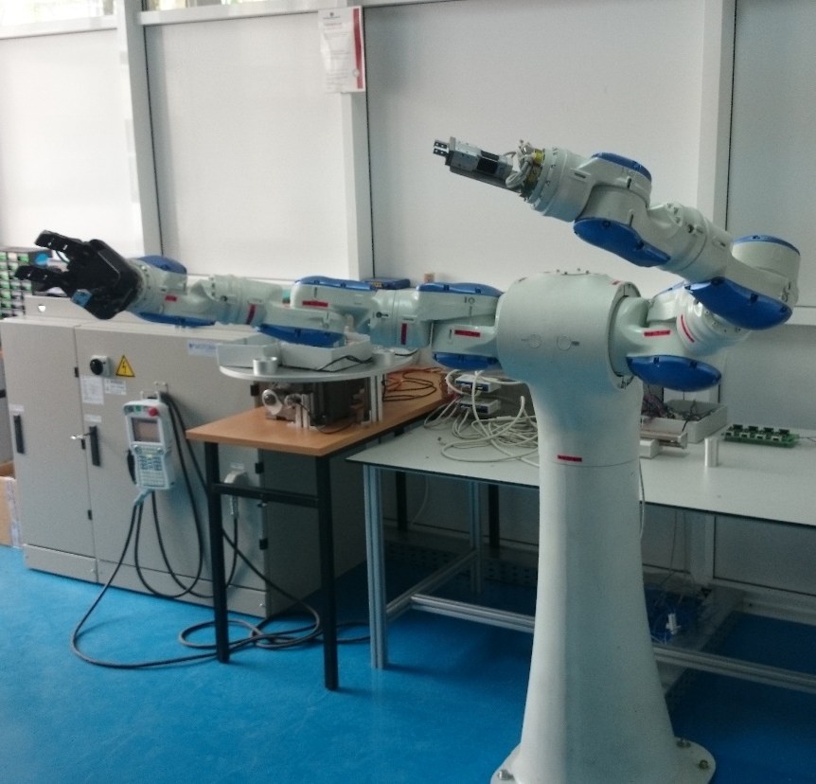
The ground technical challenge
SMART force sensor
SMART index table
SMART robot
From
Smart
Unit
To
SMART
Unit
Plug and play
SMART Integrated
System
SMART
2-finger gripper
SMART
3-finger gripper
Self (re)configurable
Self integrable
Instant interoperable
Intuitive
SMART
integrator, reconfigurator, sclator
Unit
Instant remote connectable
+ .… (see reconfigurability)
Employ and deploy PSS concept within SMART manufacturing resources

Slide 9


The SMART manufacturing resource
Shall provide
Software real-time
Distributed control
Virtual model of controlled equipment
Network enhanced
Framework for additional functionalities
Instant integration in the higher level system (interoperability, intuitiveness, (re)configurability, dynamic programmability, self adaptability, etc.)
+ Incorporated servitization functionalities
Cn
Storage
Computation & knowledge
N e t w o r k
Virtual model of sensor / actuator
Middleware & RTOS
Embedded system
Sensor / Actuator

Slide 10
Putting the concept into practice

Slide 11
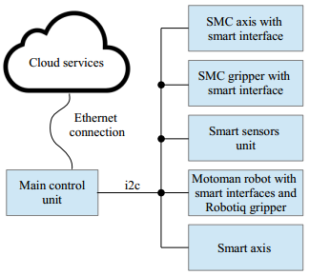
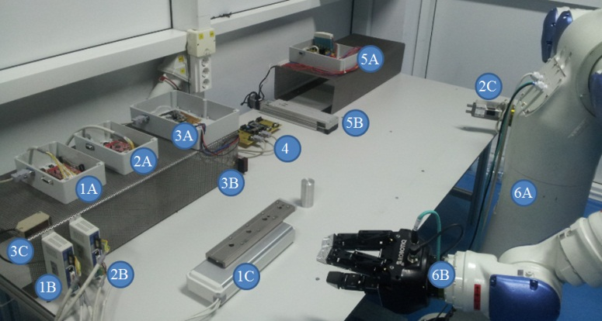
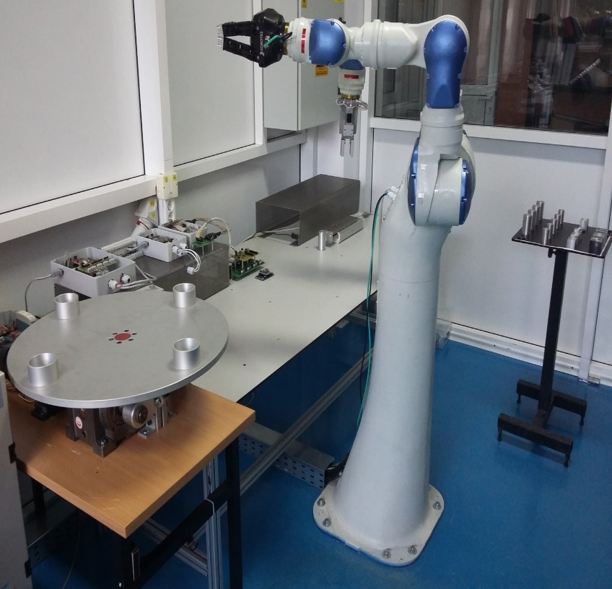
Experimental test bench

Slide 12
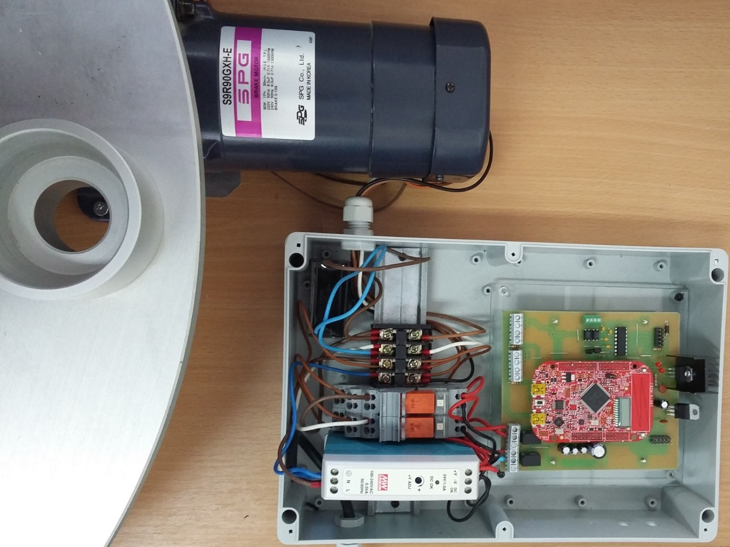
Enhancing a classical motor with SMARTNESS to operate a manufacturing resource
[an index table]

Slide 13
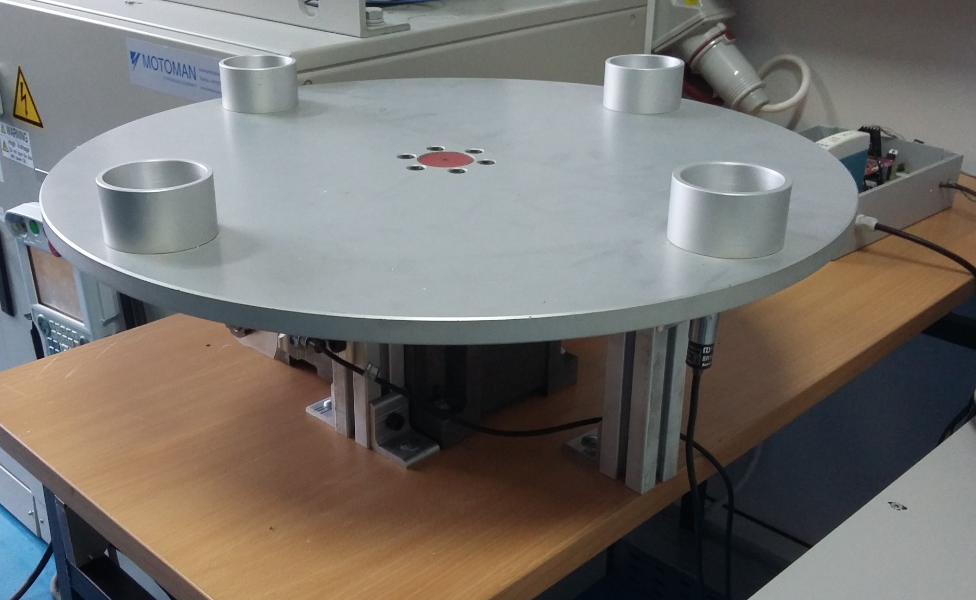
Enhancing the index table with SMART sensors
Part detection
90 ° sensor

Slide 14
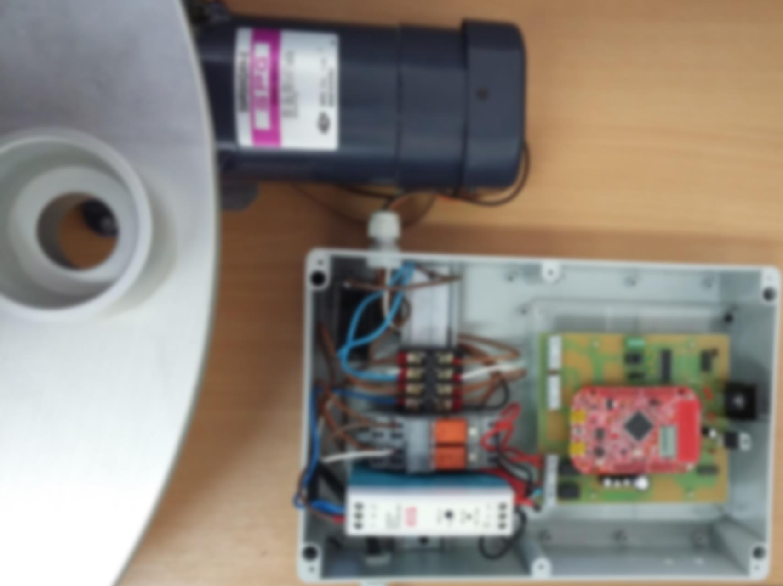
Extend functionalities of the index table
Extended functionalities
Preventive maintenance
Supports additional
functionalities
Two directions
Allows connecting
sensors
Distributed control
Monitoring
operating time

Slide 15
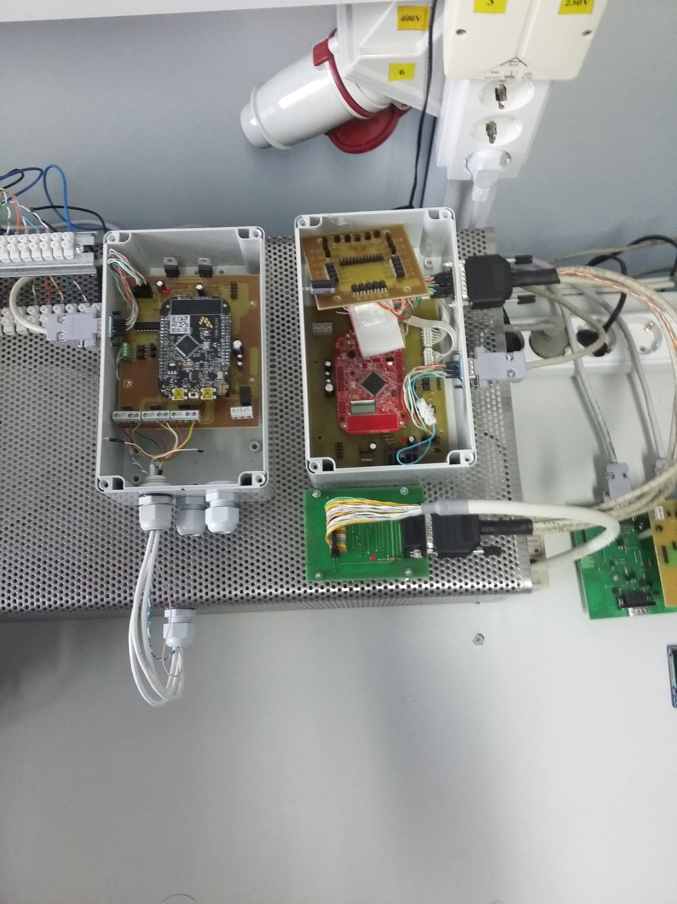
Exemplification of the sensor hub
Extended functionalities:
  Preventive maintenance
  Distributed control
  Monitoring operating time
  Ability to trigger alarms
  Up to 3 digital sensors
  Support additional functionalities

Slide 16
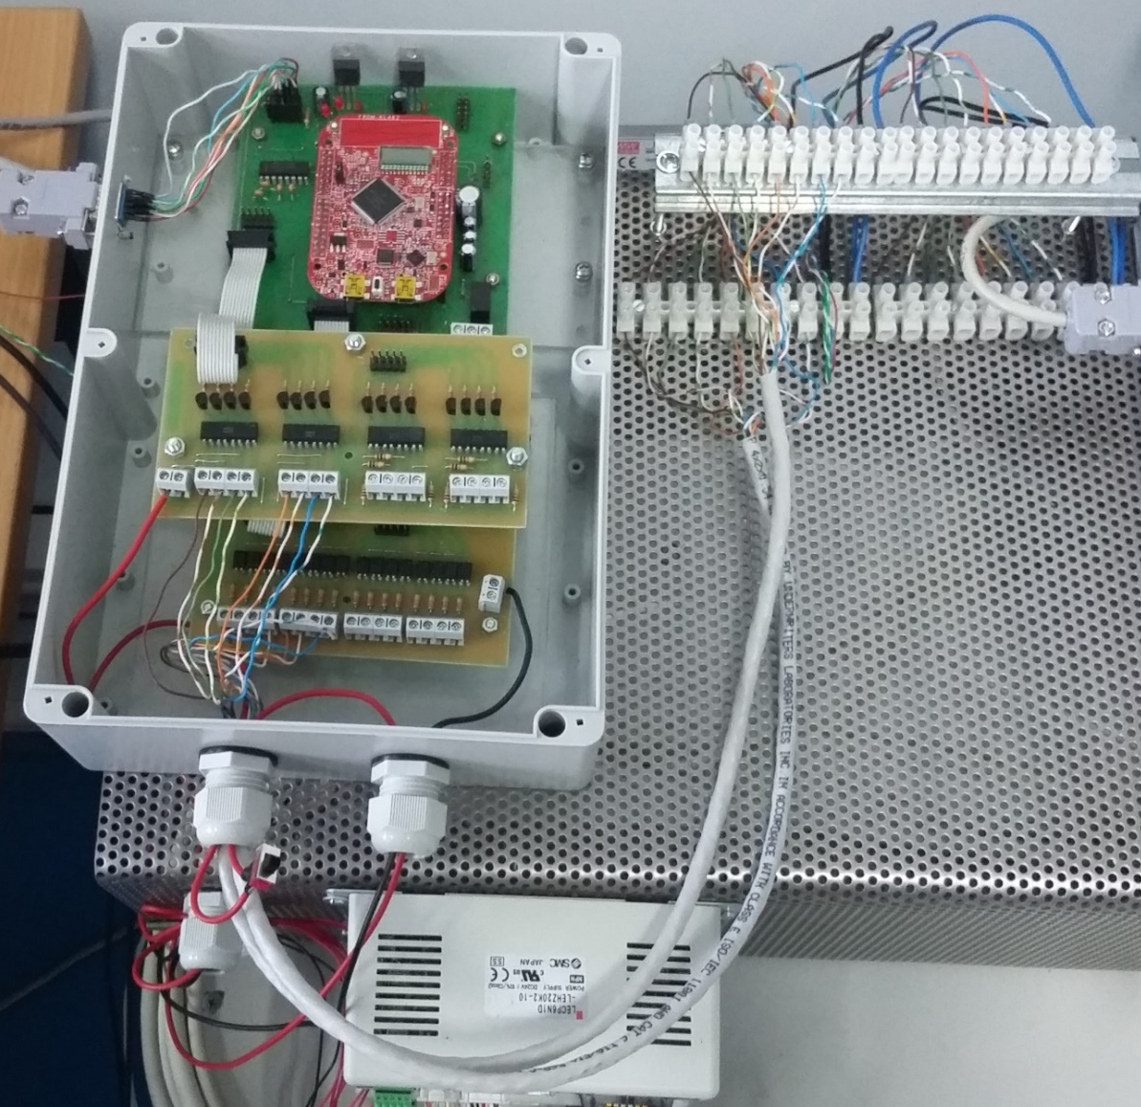
Fast integration of robot controller via a smart interface

Slide 17

Extended robot controller functionalities via a smart interface
Extended functionalities
Supports additional
functionalities
Connects to
robot IO board
Ability to control
Robotiq gripper
Monitors
operating time
Distributed control

Slide 18
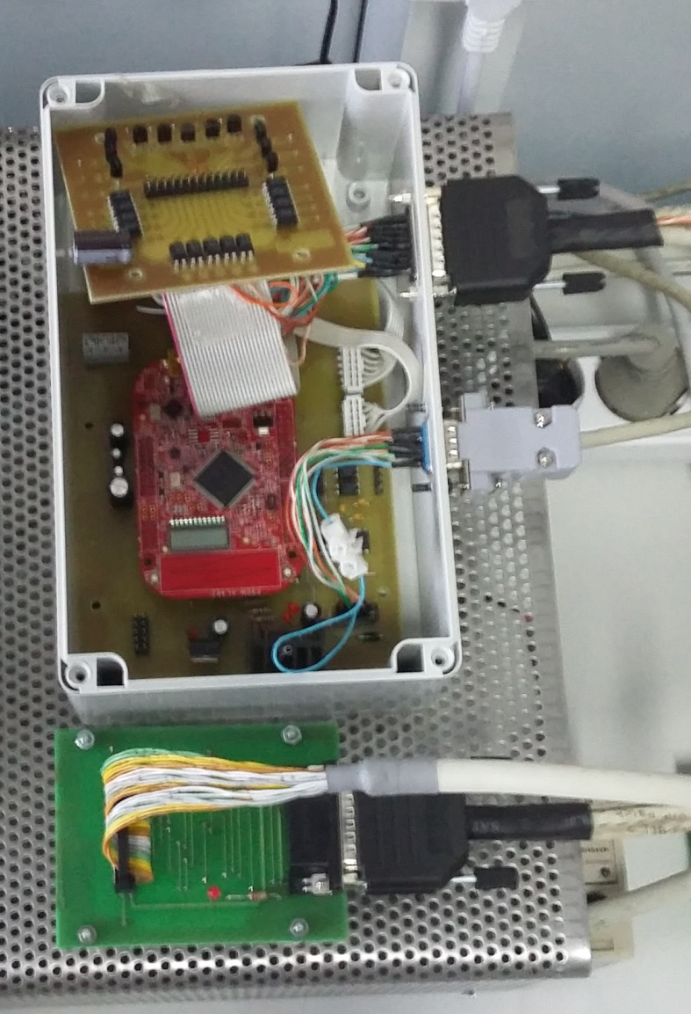
Fast integration of SMC kinematic axis via a smart interface
Extended functionalities:
  Preventive maintenance
  Monitoring operating time
  Ability to trigger alarms
  Interface SMC gripper controller for better control
  Ability to configure local control based on process data

Slide 19
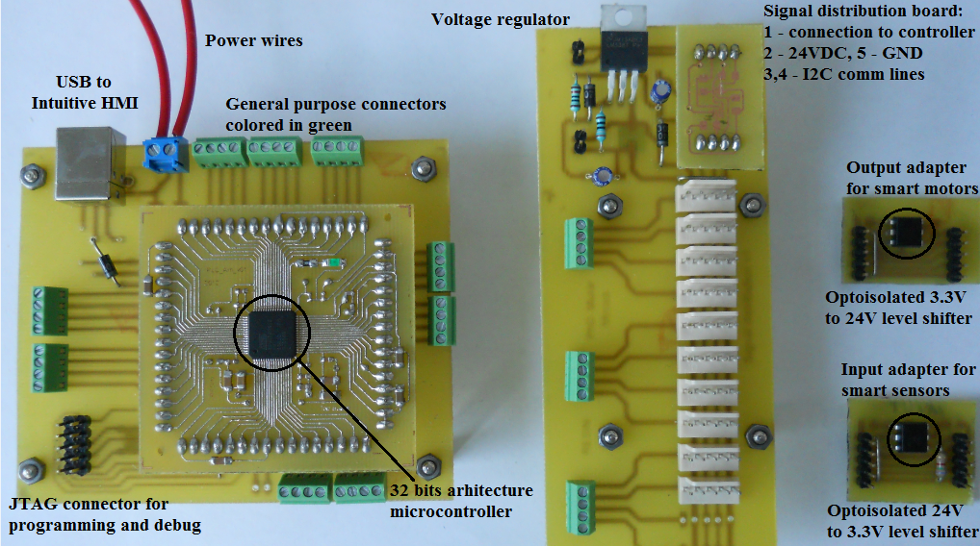
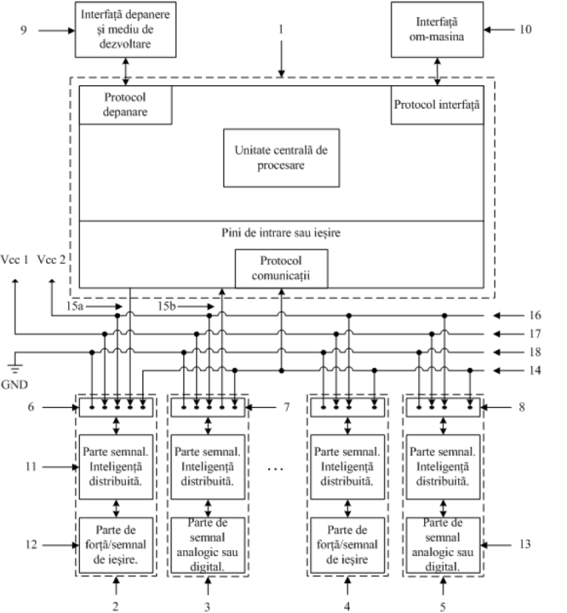
Smart integrator unit

Slide 20
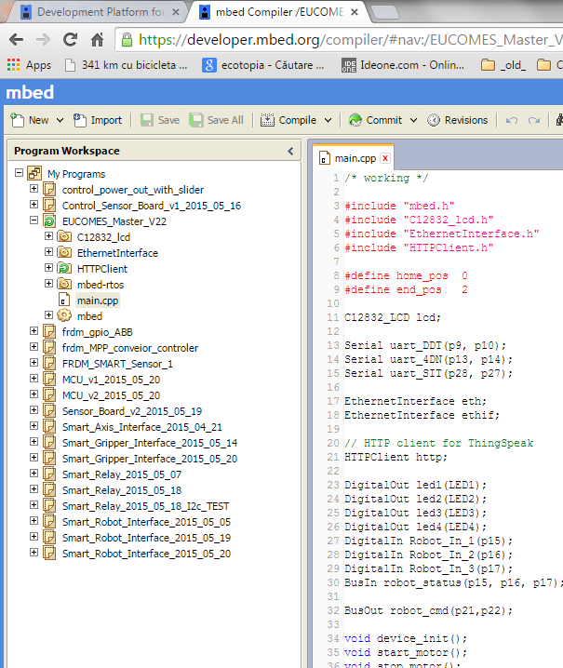
Incorporating servitization capability within smart units
Functionalities / software modules developed within cloud environment (mbed.org).
Functionalities loaded from online repository through a USB cable within the embedded designs framework
Each smart unit and interface has its own control board consisting of a FRDM-KL46Z mbed platform running on an ARM Cortex-M0+ processor at 46 MHz
[download functionalities
from the cloud]

Slide 21
Experimentation

Slide 22
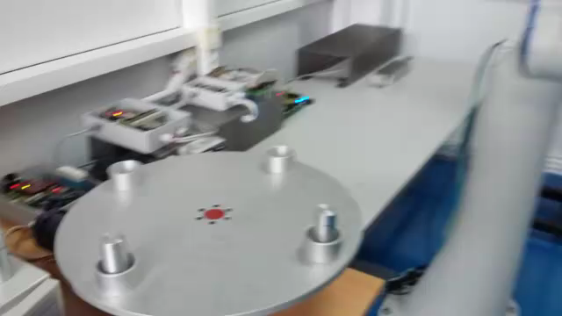
Scenario A :: part manipulation

Slide 23
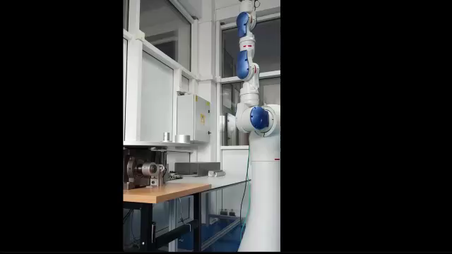
Scenario B :: rapid and intuitive integration of a new functionality [alarm signal]

Slide 24
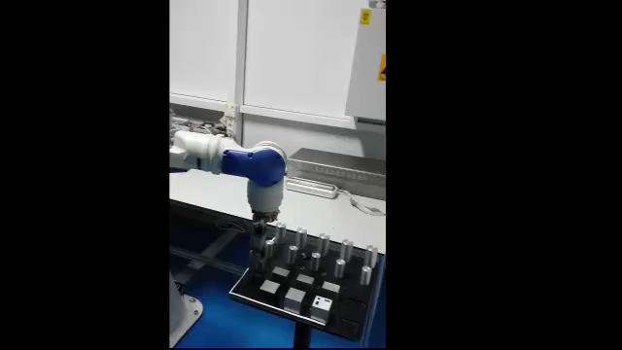
Scenario C :: need to add a new smart axis and change the task

Slide 25
Results and further researches

Slide 26
Results
Innovations towards fast integrative and interoperable smart units
Development of smart units
Development of software functionalities / services
Deploying re-configurability by employing smart units and software functionalities with respect to hardware constraints

Slide 27
Further researches
Researches
  Deployment of small granularity software packages for efficient functionalities development
  Development of generic hardware modules
Constraints
  Broad availability of proprietary manufacturing equipment
  Lack of open source software from manufacturers side
NEED A GLOBAL INITIATIVE FOR STANDARDIZATION AND CLUSTERING
Inspirational initiatives:
KNX Community http://www.knx.org/knx-en/community/index.php
IoT Global Standard Initiative http://www.itu.int/en/ITU-T/gsi/iot/Pages/default.aspx

Slide 28
Questions?
For collaboration you can contact us at:
Stelian Brad | stelian.brad@staff.utcluj.ro
Mircea Murar | mircea.murar@muri.utcluj.ro

